Slide 1
designing for data-driven organizations
@bitsybot
Bitsy Bentley
Director of Data Visualization, GfK

Slide 2
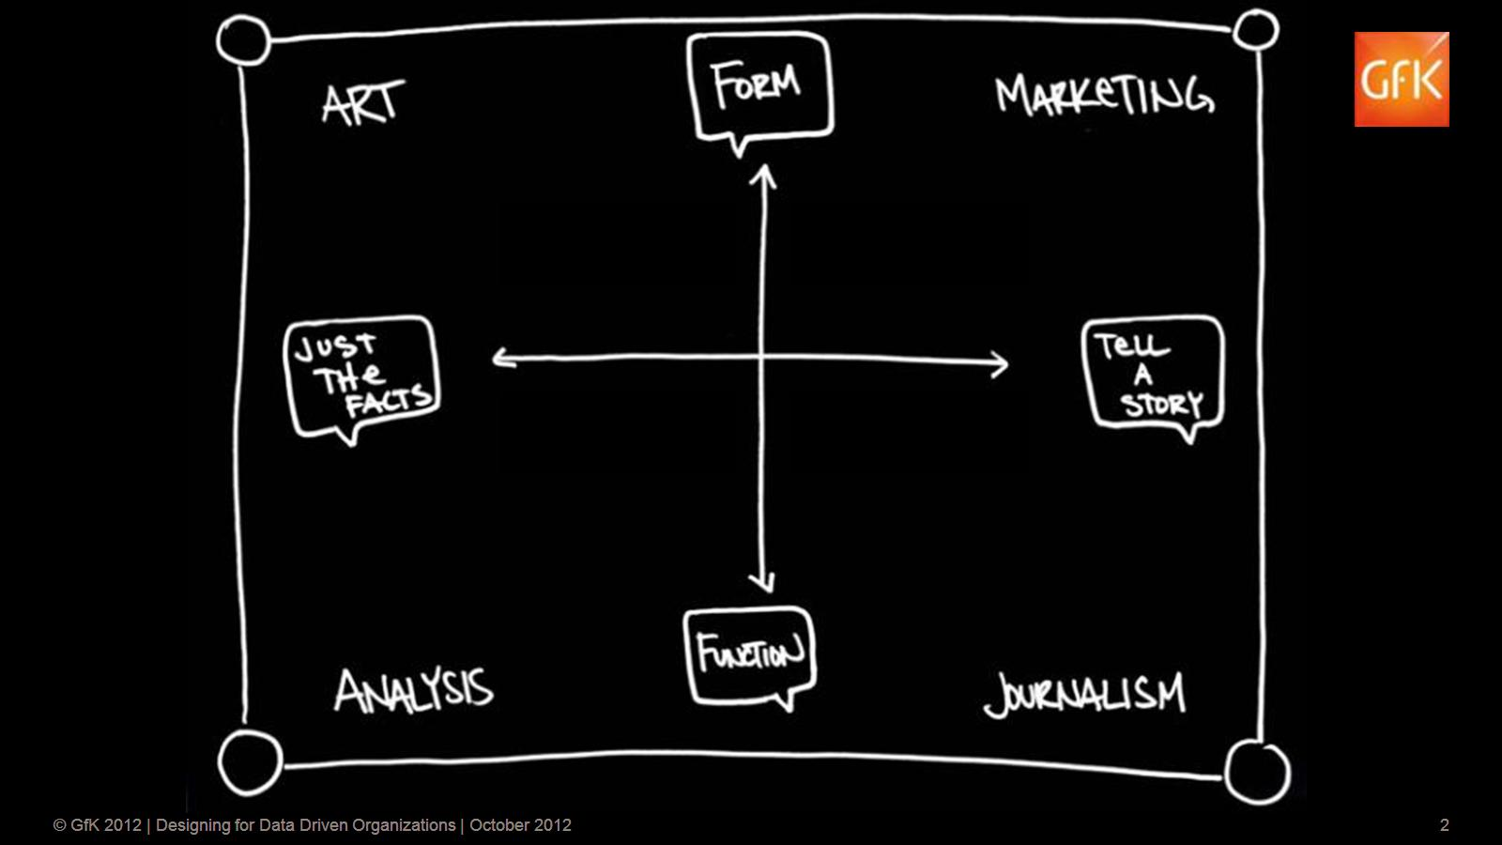

Slide 3
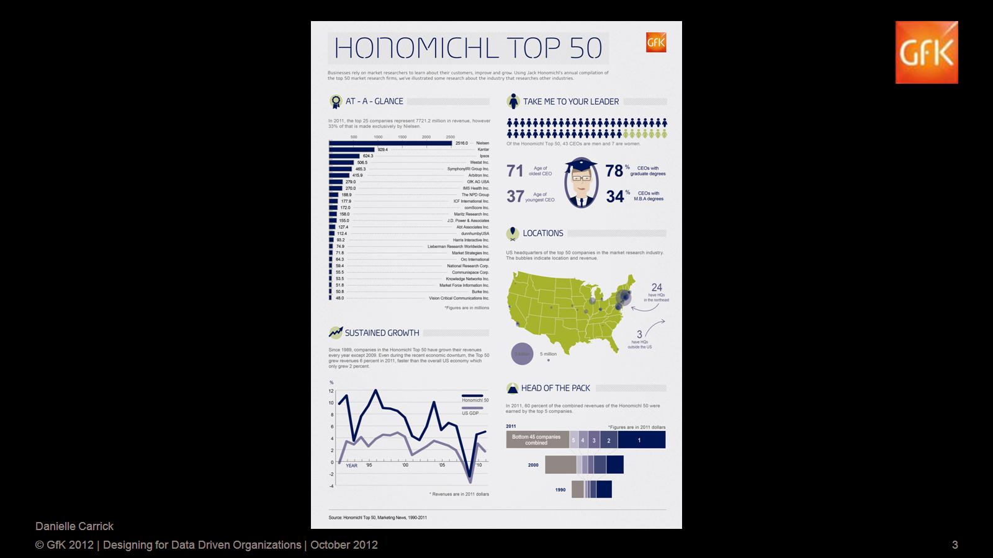

Slide 4
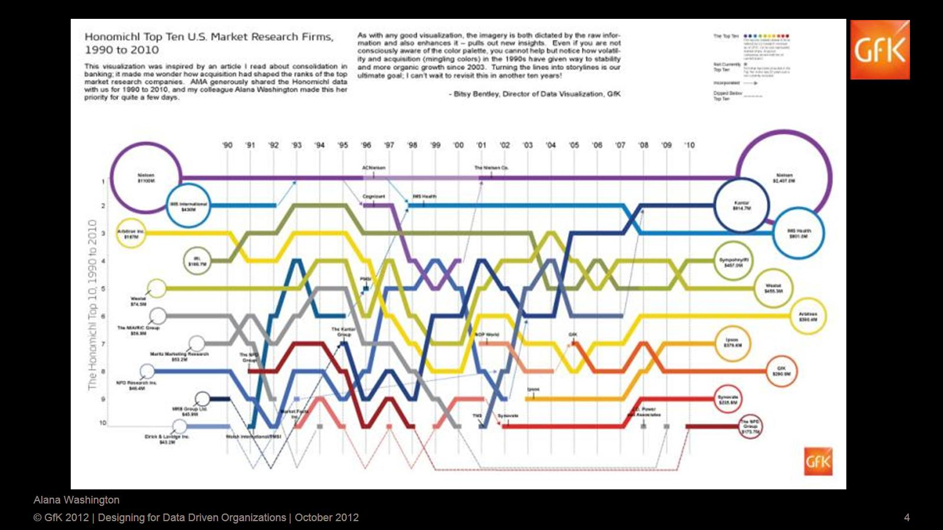

Slide 5
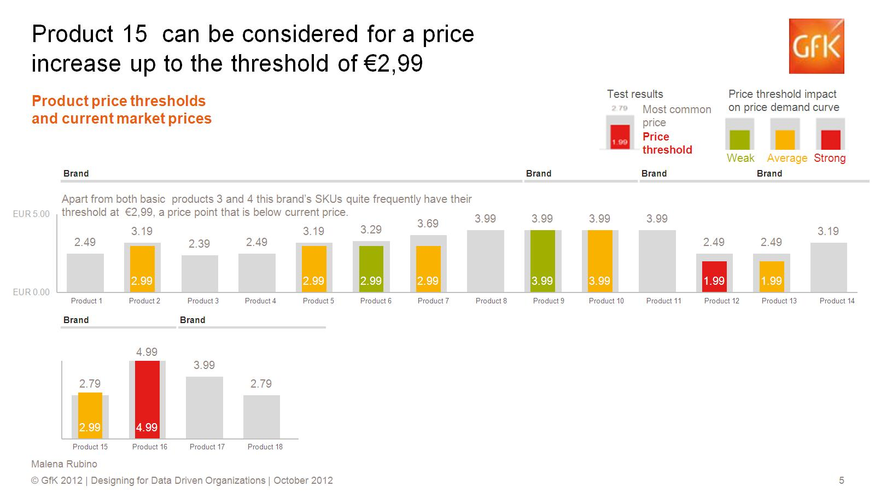
Product 15 can be considered for a price increase up to the threshold of €2,99

Slide 6
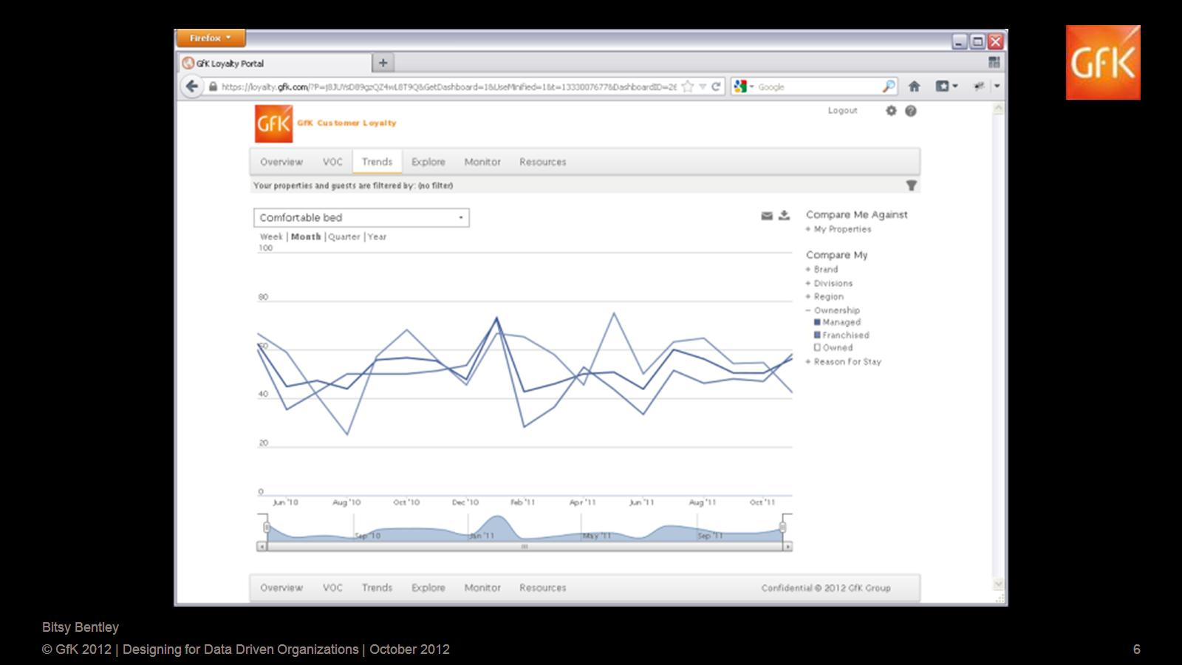

Slide 7


Slide 8

Design inspiration

Slide 9
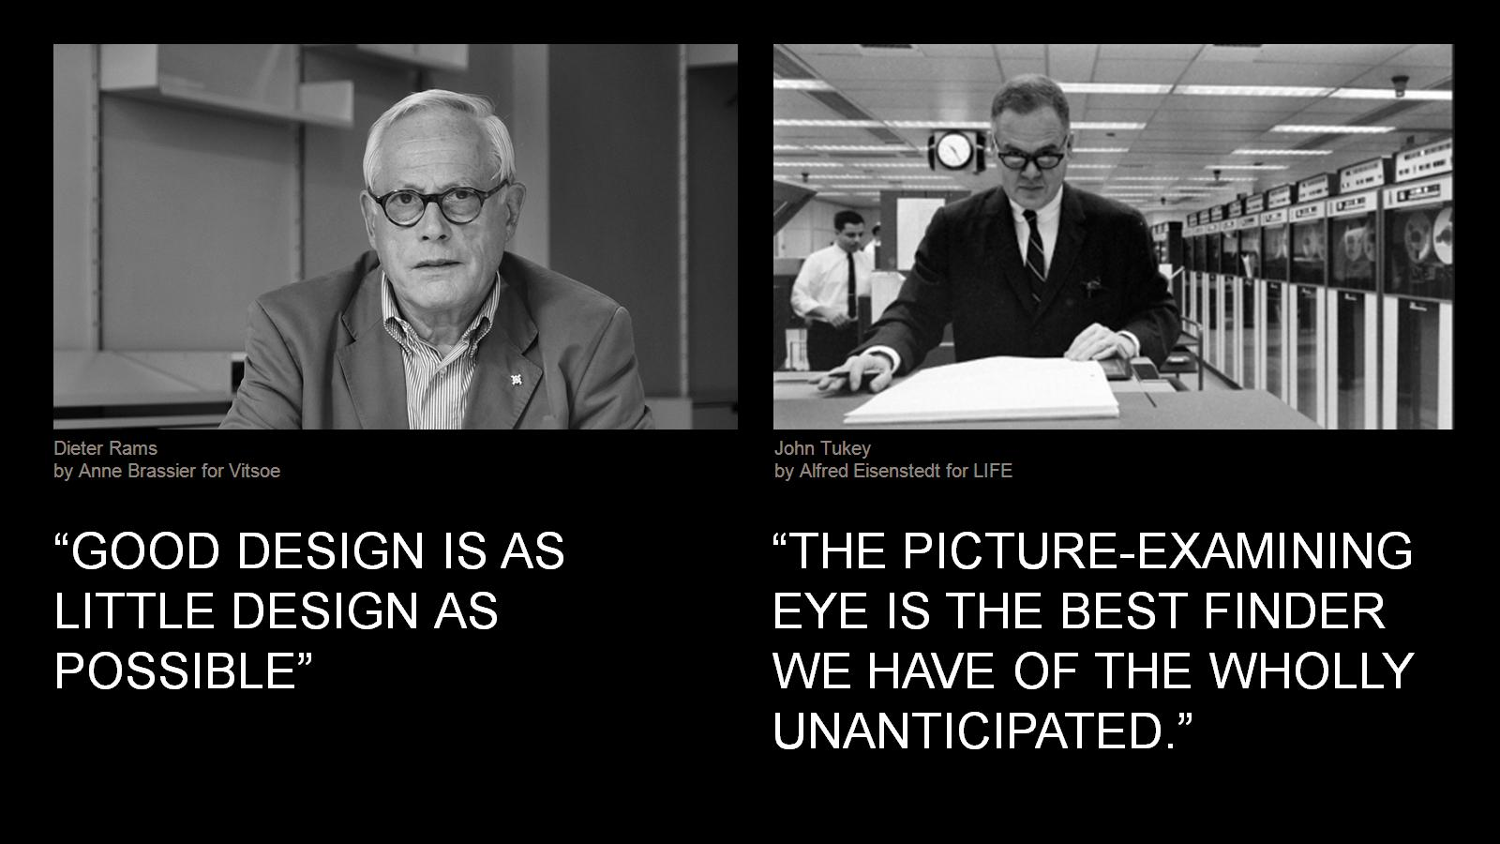

Slide 10
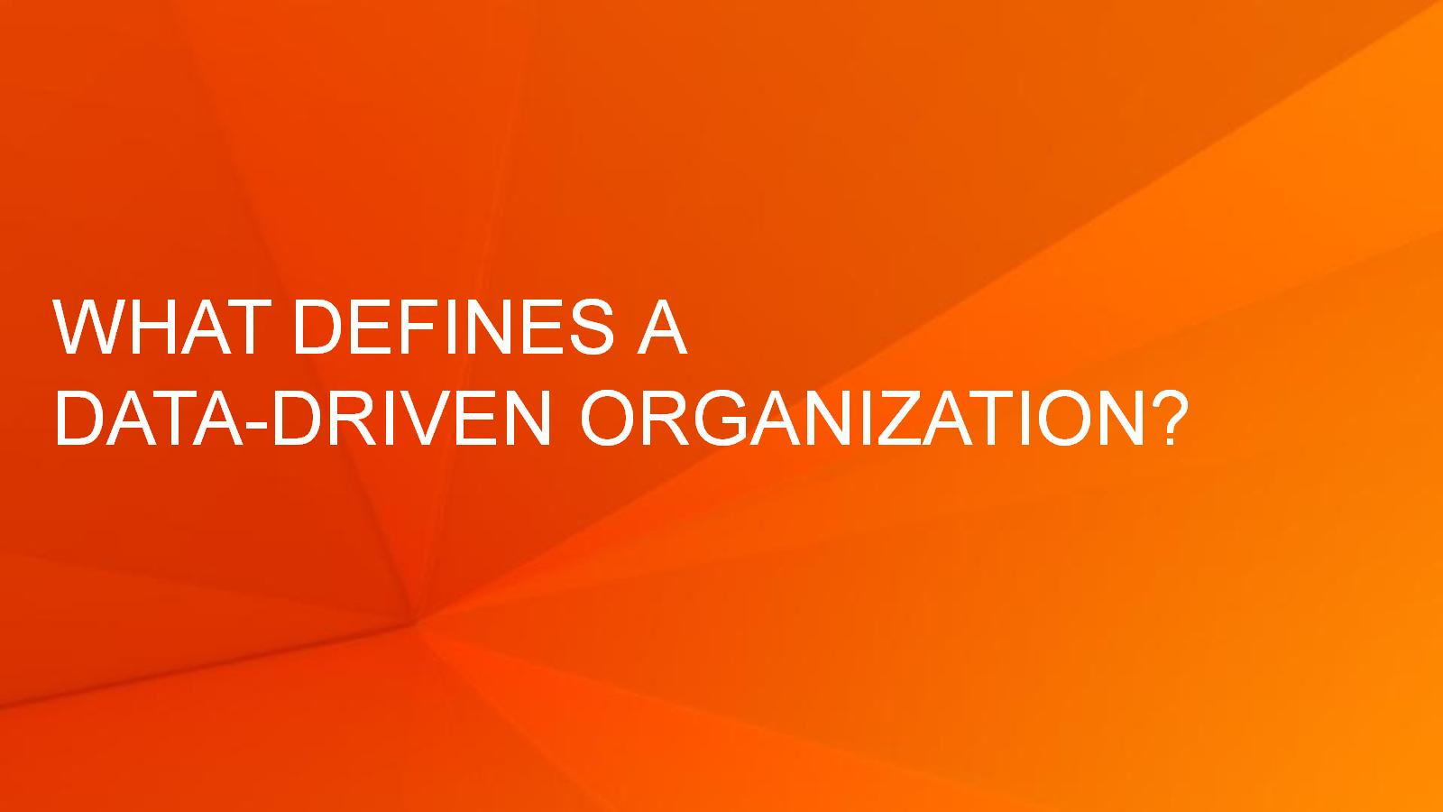
What defines a data-driven Organization?

Slide 11
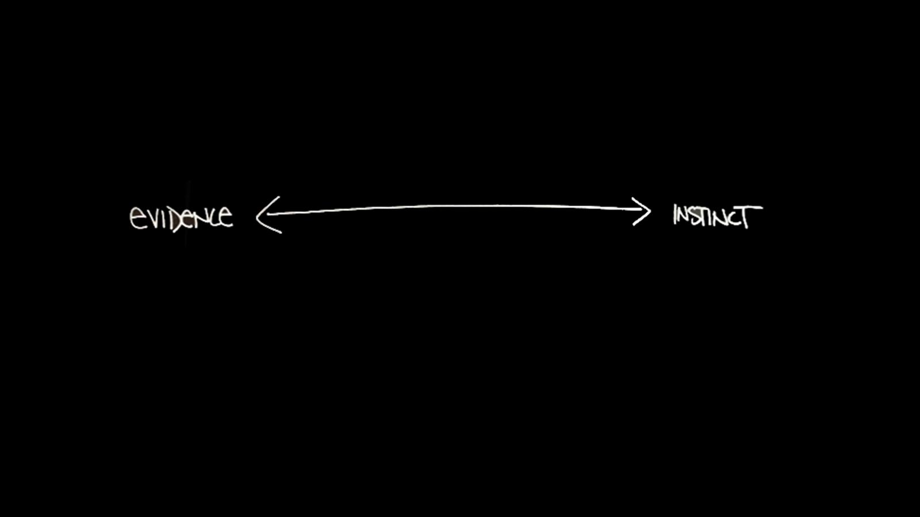


Slide 12
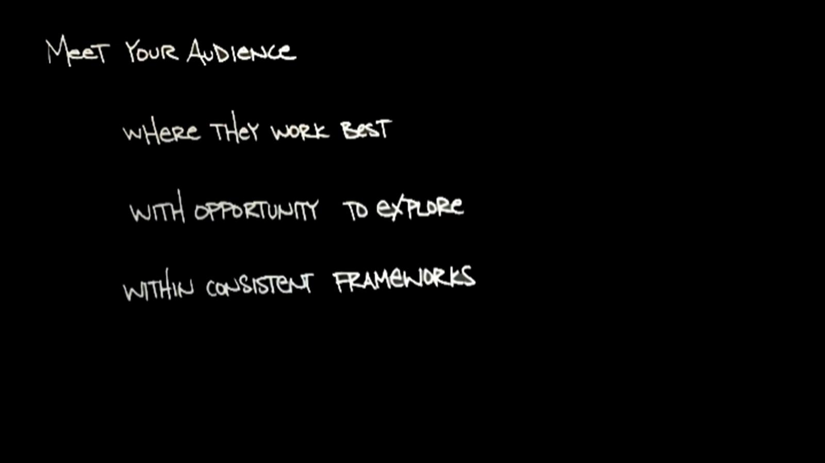

Slide 13










Slide 14










Slide 15










Slide 16
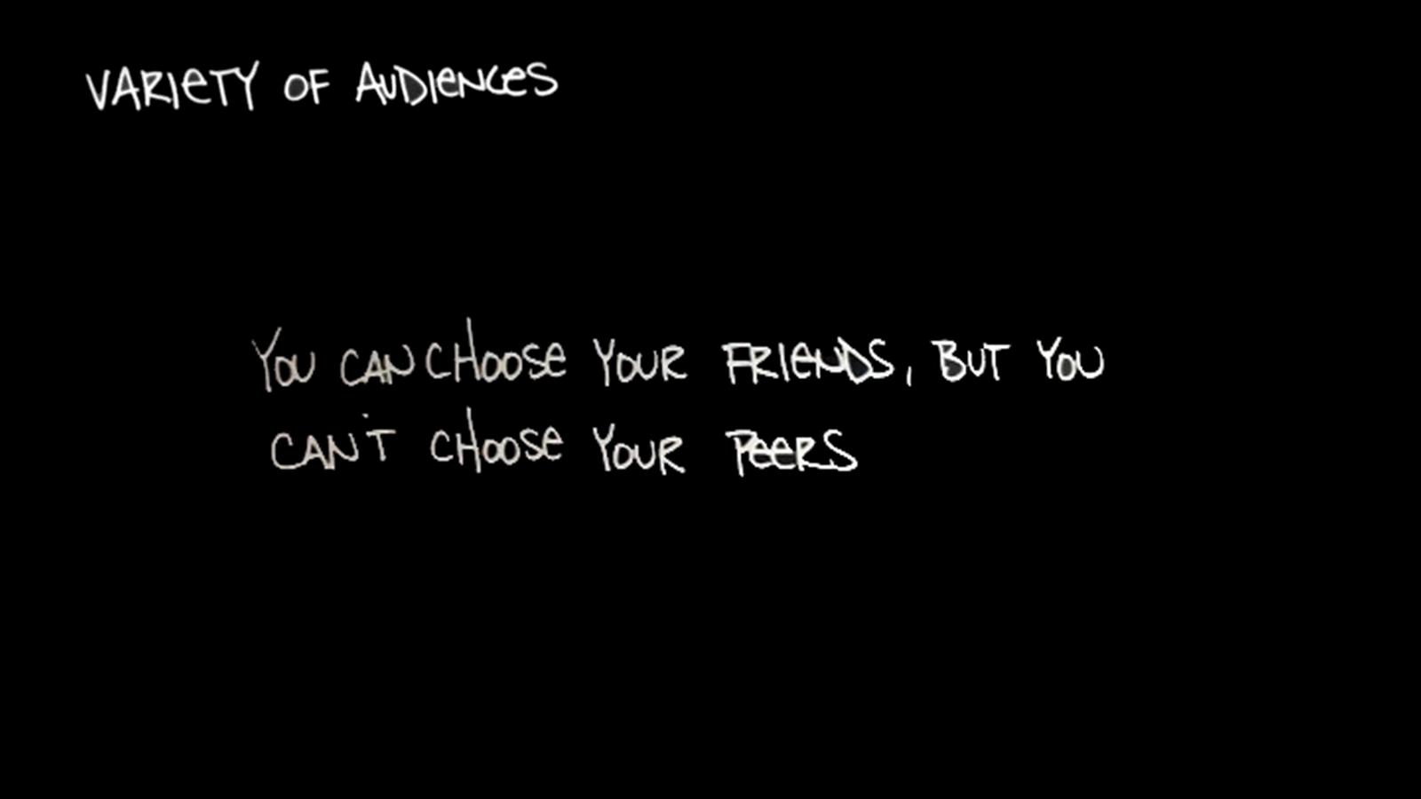
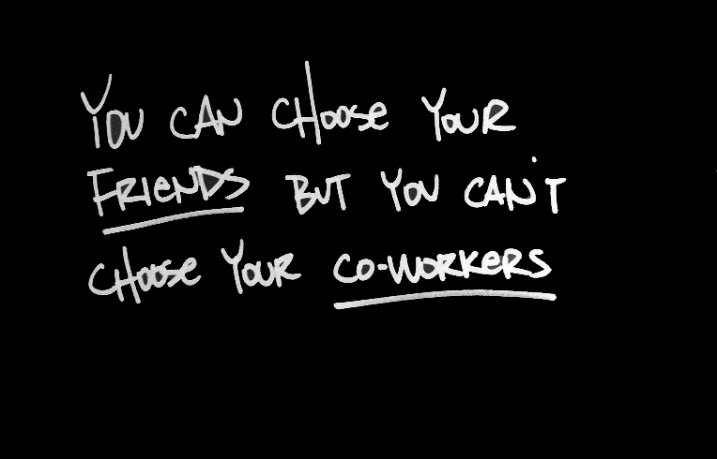

Slide 18
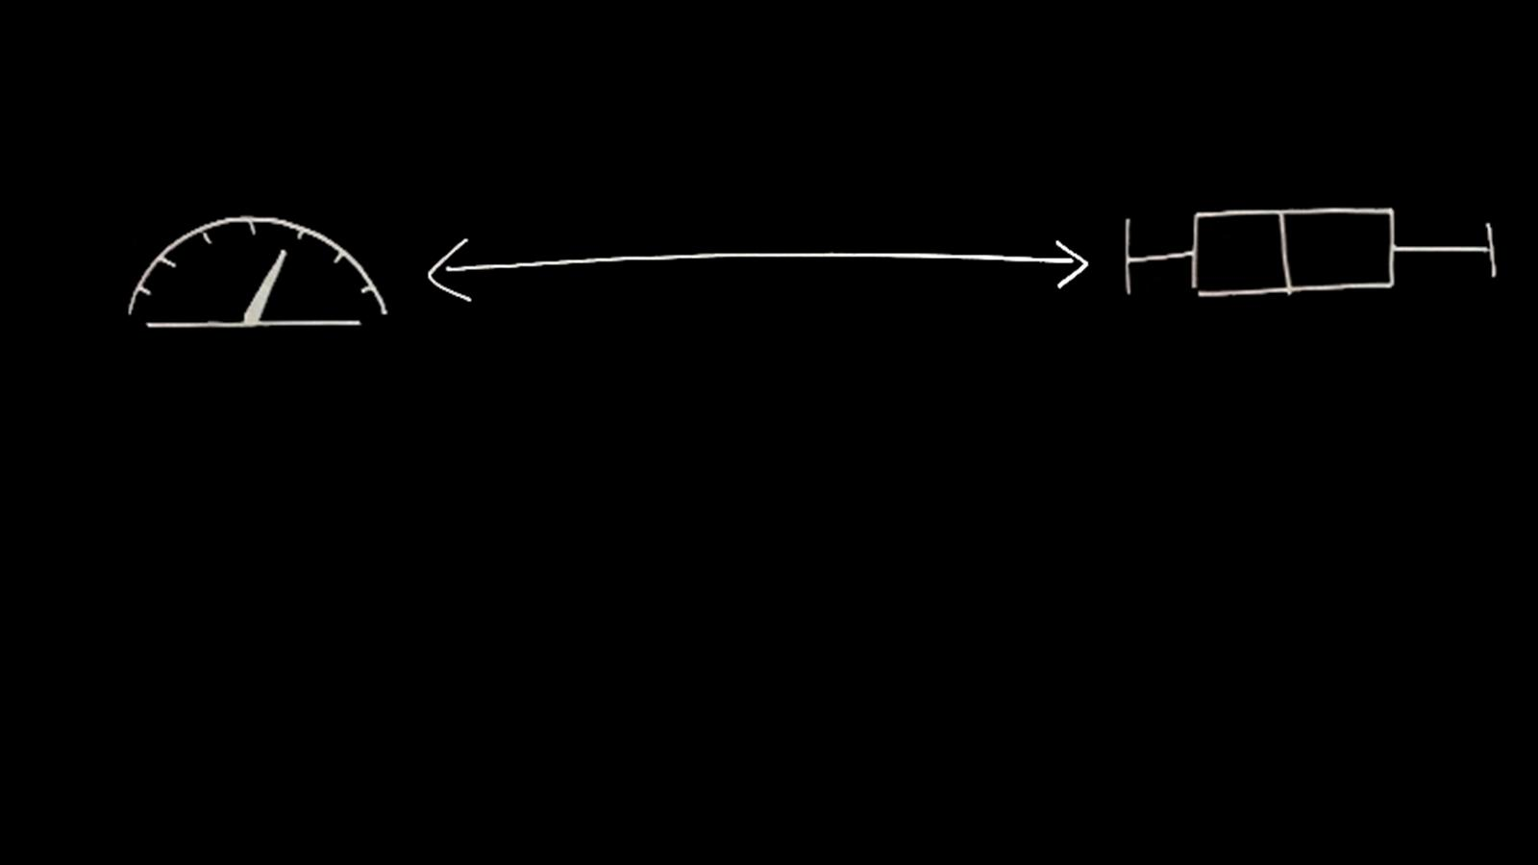
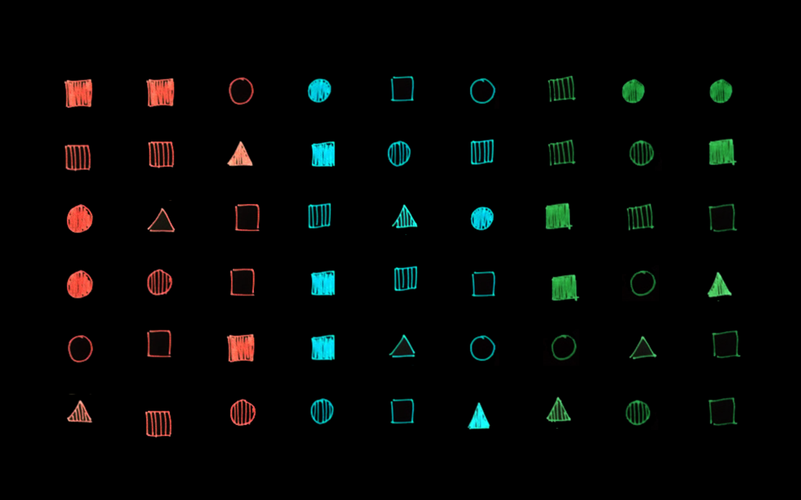

Slide 19
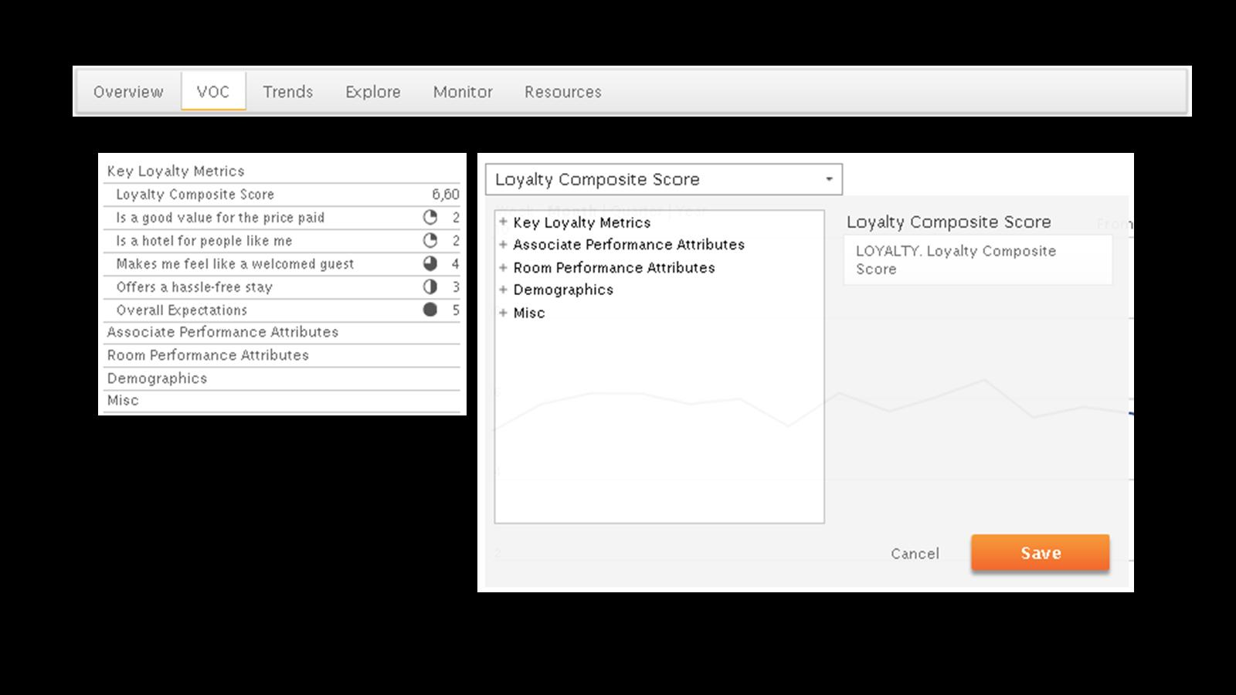
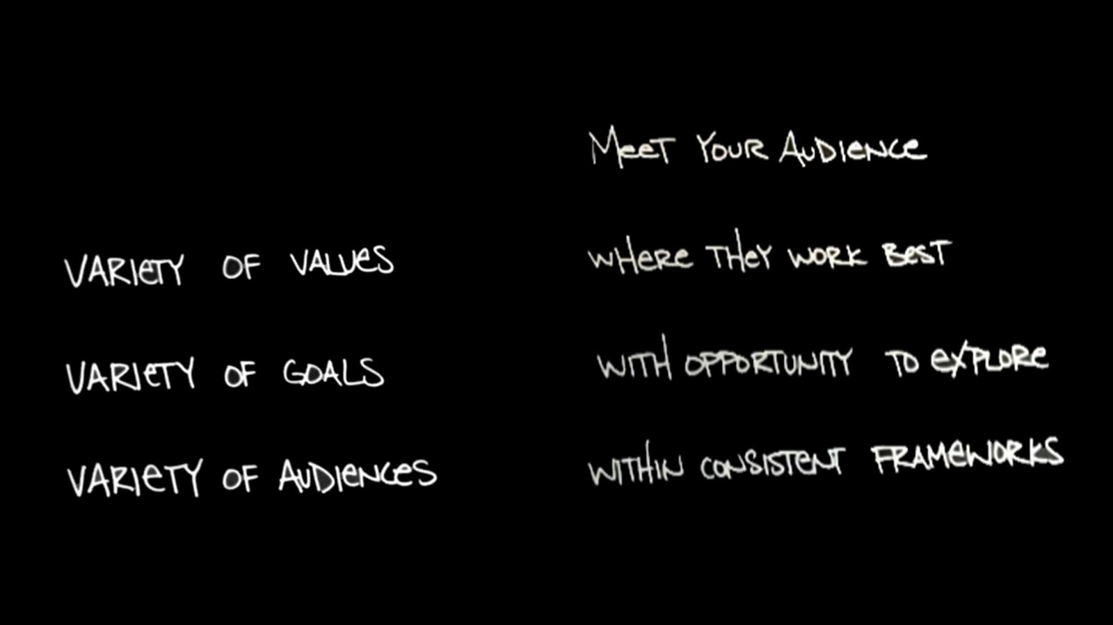

Slide 20
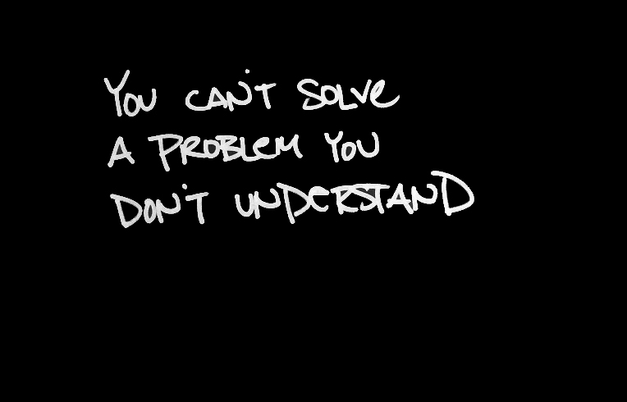

Slide 24
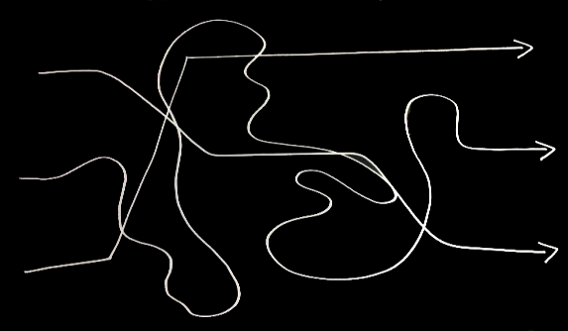

Slide 25
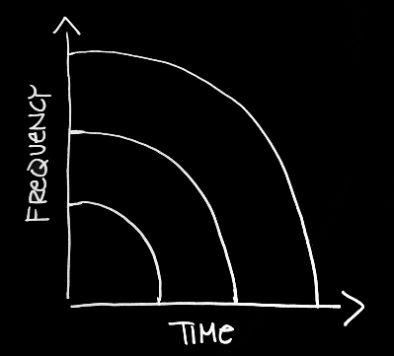

Slide 27




Slide 28


Slide 29


Slide 31




Slide 34
designing for data-driven organizations
@bitsybot
Bitsy Bentley
Director of Data Visualization, GfK

